Slide 1

AWS
Lecture 3
www.corvit.com

Slide 2
Topics
AWS VPC (Virtual Private Cloud)
VPC Components
VPC Types
Subnets
Implied Route & Route Table
Internet Gateway
NAT Gateway
Security Groups
Network ACL
VPC Peering
Create VPC, Subnet, Internet Gateway and Route Table
Accessing Private Subnet Resources from Public Subnet Resources
VPC to VPC Peering
Configuring Custom Network ACL with VPC
VPN Connection
www.corvit.com

Slide 3
AWS Virtual Private Cloud (VPC)
A Virtual Private Cloud is a Virtual Network that closely resembles a traditional Networking that you operate in your own data center, with the benefit of using the scalable infrastructure of AWS.
VPC is a Virtual Network or Data Centre inside AWS of one Client.
It is logically Isolated from Virtual Network in the AWS cloud.
Max 5 VPC can be created and 200 subnets in 1 VPC
We can allocate max 5 Elastic IP.
Once we created VPC, DHCP, NACL and Security group will be automatically created.
A VPC is confined to an AWS Region and does not extend between Regions.
Subnets created in VPC are confined to Availability Zone.
www.corvit.com

Slide 4
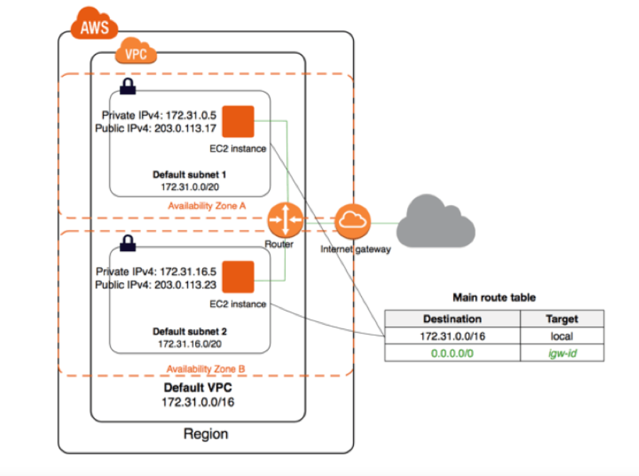
AWS VPC
Once the VPC is created you cannot change its CIDR Block Range.
If you need a different CIDR size, create a New VPC. But AWS had given new feature of Primary and Secondary CIDR so you can create a secondary CIDR. (This feature is not available in AWS China and US Govt. Cloud.)
The different Subnets within a VPC cannot overlap.
You cannot have the same VPC CIDR for different VPC’s in the same region in a account. Different Accounts can have same CIDR address in the same region except when you want them to peer.
www.corvit.com

Slide 5
VPC Components
CIDR & IP address
Subnets
Implied Router & Routing Table
Internet Gateway
Security Groups
Network ACL
Virtual Private Gateway
Peering Connections
Elastic IP
www.corvit.com

Slide 6
VPC Types
Default
Custom
Created in each AWS Region when the AWS Account is created.
Has default CIDR, Security Group, NACL and Route Table Settings.
Has an Internet Gateway by default.
Is a VPC an AWS account Owner creates.
AWS user creating the custom VPC can decide the CIDR.
Has its own default Security Group, Network ACL and Route Tables.
Does not have an Internet Gateway by default, need to be created if needed.
www.corvit.com

Slide 7
Resources needed to Initialize VPC
Create VPC
Subnet
Internet Gateway
Route Table
www.corvit.com

Slide 8
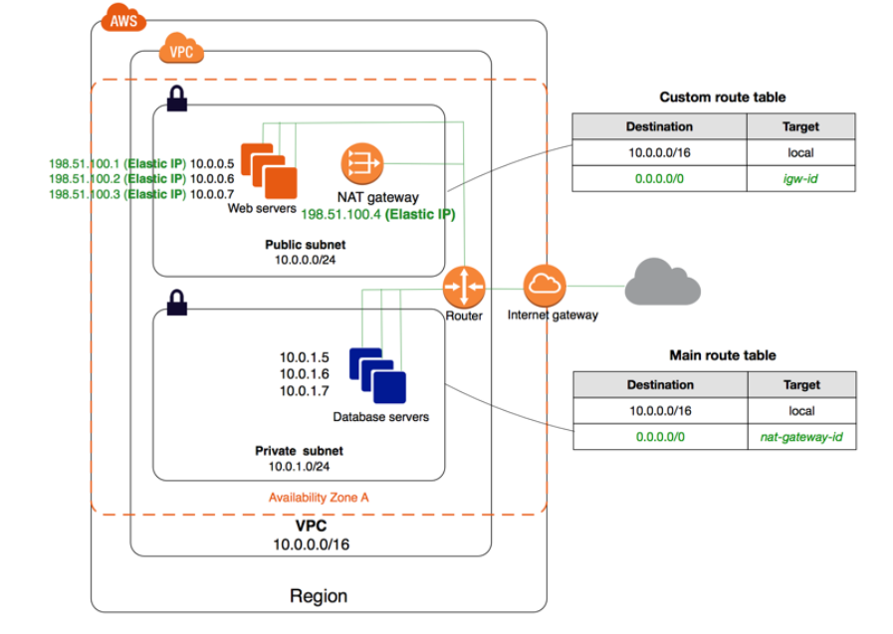
Subnets in VPC
Public Subnet: If a subnet’s traffic is routed to an Internet Gateway, the subnet is known as Public Subnet. If you want your instance in a Public subnet to communicate with the internet over IPv4, it must have a public IPv4 address or an Elastic IP address.
Private Subnet: If a subnet does not have a route to the internet gateway, the subnet is known as Private Subnet.
When you create a VPC you must specify on IPv4 CIDR Block for the VPC. The allowed block size is between /16 to /28.
NAT gateway would be created in Public subnet but it is used for Private subnet for the internet access.
www.corvit.com

Slide 9
Reserved IPs in AWS VPC Subnet
The first 4 and last IP address of subnet cannot be assigned.
For e.g. 10.0.0.0/24
- 10.0.0.0: Network ID
- 10.0.0.1: Reserved by AWS for the VPC Router
- 10.0.0.2: Reserved by AWS , The IP address of DNS Server.
- 10.0.0.3: Reserved for future use.
- 10.0.0.255: Broadcast Address
AWS do not support Broadcast in a VPC but Reserve the address.
www.corvit.com

Slide 10
Implied Route & Route Table
It is the Central Routing Function
It connects the different AZ together and connects the VPC to the Internet Gateway
You can have up to 200 Route tables per VPC
You can have up to 50 Routes Entries per Route table
Each Subnet must be associated with only one Route table at any given time
If you not specify a subnet to route table association, the subnet will be associated with the default VPC Route table
You can also edit the Main Route table if you needbut you cannot delete main Route Table.
However you can make a Custom Route table manually become the main Route table then you can delete the former main as it is no longer a main Route table.
You can associate multiple Subnets with the same Route table.
www.corvit.com

Slide 11
Internet Gateway
An Internet Gateway is a Virtual Router that connects a VPC to the internet.
Default VPC is already attached with an Internet Gateway.
If you create a new VPC then you must attach the Internet Gateway in order to access the Internet.
Ensure that your Subnet’s Route table points to the Internet Gateway
It performs NAT between your private and public IPv4 address
It support both IPv4 and IPv6
www.corvit.com

Slide 12
NAT Gateways
You can use a Network Address translation Gateway to enable instances in a private subnet to connect to the internet or other AWS services but prevent the internet from initiating a Connection with those Instances
You are charged for creating and using a NAT Gateway in your account NAT Gateway hourly usage and data processing rates apply. Amazon EC2 charges for data transfer also apply
To create a NAT Gateway you must specify the Public Subnet in which the NAT Gateway should reside.
You must also specify an Elastic IP address to associate with NAT Gateway when you create it
No need to assign public IP address to your Private instance.
www.corvit.com

Slide 13
NAT Gateways
After you have Created a NAT Gateway you must update the Route table associated with one or more of your Private Subnets to point Internet Bound Traffic to the NAT Gateway
This enables instances in your private subnet to communicate with the internet
Deleting a NAT Gateway disassociates its Elastic IP address but does not release the address from your account.
www.corvit.com

Slide 14
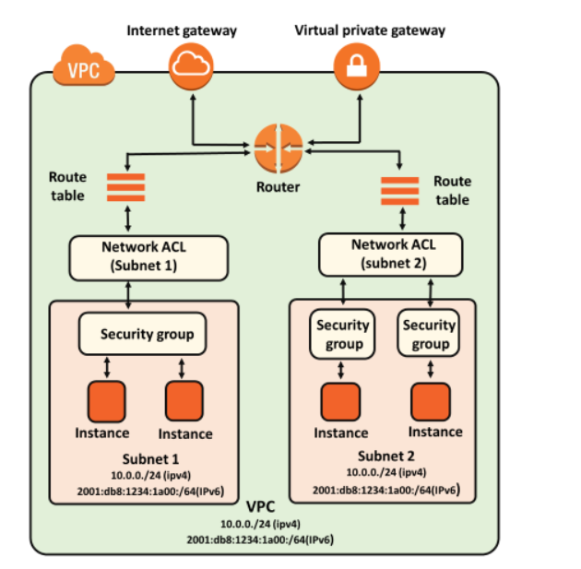
Security Groups
It is a Virtual Firewall which works at instance level
Up to 5 Security Groups per EC2 instance interface can be applied.
Can only have permit Rules but cannot have deny rule
Stateful, return traffic , inbound traffic is allowed even if there are no rules to allow it.
www.corvit.com

Slide 15
Network ACL
It is a function performed on the Implied Router
NACL is an optional layer of security for your VPC that acts as firewall for controlling traffic in or out of one or more subnets
Your VPC automatically comes with a modifiable default Network ACL by default it allows all inbound and outbound IPv4 traffic and if applicable IPv6 traffic.
You can create a Custom Network ACL and associate it with a subnet.
By default each custom Network ACL denies all inbound and outbound traffic until you add rules.
www.corvit.com

Slide 16
Network ACL
Each subnet in your VPC must be associated with a Network ACL. If you don’t explicitly associate a subnet with Network ACL the subnet is automatically associated with the default Network ACL
You can associate a NACL with multiple subnet, however a subnet can be associated with only one NACL at a time.
When you associate a NACL with a subnet the previous association is removed.
A NACL contains a numbered list of rule that we evaluate in order, starting with the lowest numbered rule.
www.corvit.com

Slide 17
Network ACL
The highest number that you can use for a rule is 32766.
Recommended that you start by creating rules with rule number that is a multiple of 100, so that you can insert new rules where you need later.
It functions at subnet level
NACL are stateless, outbound traffic for an allowed inbound traffic, must be explicitly allowed too.
You can have permit and deny rules in a NACL
www.corvit.com

Slide 18
Security Group vs NACL
Security Group
NACL
It supports only allow rules, and by default, all the rules are denied. You cannot deny the rule for establishing a connection.
It is a stateful means that any changes made in the inbound rule will be automatically reflected in the outbound rule. For example, If you are allowing an incoming port 80, then you also have to add the outbound rule explicitly.
It is associated with an EC2 instance.
All the rules are evaluated before deciding whether to allow the traffic.
Security Group is applied to an instance only when you specify a security group while launching an instance.
It is the first layer of defense.
It supports both allow and deny rules, and by default, all the rules are denied. You need to add the rule which you can either allow or deny it.
It is a stateless means that any changes made in the inbound rule will not reflect the outbound rule, i.e., you need to add the outbound rule separately. For example, if you add an inbound rule port number 80, then you also have to explicitly add the outbound rule.
It is associated with a subnet.
Rules are evaluated in order, starting from the lowest number.
NACL has applied automatically to all the instances which are associated with an instance.
It is the second layer of defense.
www.corvit.com

Slide 19
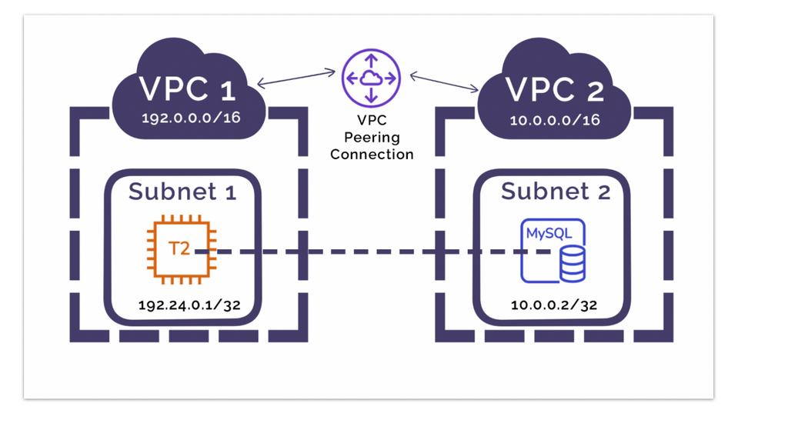
VPC Peering
A VPC Peering Connection is Networking Connection between two VPC that enables you to route traffic between them using Private Ipv4 addresses or IPv6
Instances in either VPC can communicate with each other as if they are written the same network
You can create a VPC peering Connection between your own VPC or with a VPC in another AWS account.
The VPC can be in different Region.
www.corvit.com

Slide 20
Create VPC, Subnet, Internet Gateway and Route Table
Create VPC then create subnet and attach to the VPC.
Use 10.0.0.0/16 for VPC and 10.0.0.0/24 for Subnet
Create Internet gateways and attach it to the VPC
https://docs.aws.amazon.com/directoryservice/latest/admin-guide/gsg_create_vpc.html
Create Route Table - Attach Subnet - Add route entry for Internet Gateway in Route Table (0.0.0.0/0)
https://docs.aws.amazon.com/vpc/latest/userguide/WorkWithRouteTables.html
Testing
- Create an EC2 instance and attach VPC - Connect to EC2 and ping 8.8.8.8
www.corvit.com

Slide 21
Accessing Private Subnet Resources from Public Subnet Resources
Create VPC and 2 Subnets in the VPC
Use 10.0.0.0/16 for VPC, 10.0.0.0/24 for Public Subnet. 10.0.1.0/24 for Private Subnet.
Create Internet Gateway and attach it to VPC
While creating Private Subnet disable auto allocate IP address option
Create 2 Route tables one for Public and the other for Private Subnet
Add route entry for Internet Gateway in Route Table of Public Subnet
Create 2 EC2 Instances, one in Public Subnet and the other in Private Subnet.
Try to connect to EC2 instance created in Private Subnet, but you won’t be able to do so
So connect to EC2 instance in Public Subnet from there RDP to EC2 instance in Private Subnet using the Private IP of that instance.
Remember Private Subnet EC2 is not open to Internet, you can only access from Public Subnet. But if you want Internet traffic to communicate with this instance you need to use NAT Gateway
www.corvit.com

Slide 22
Allowing Internet Traffic for Private Subnet Resources through NAT
Create NAT Gateway an attach it to Public Subnet with Elastic IP.
Add NAT Gateway entry in Route Table of Private Subnet.
Try ping 8.8.8.8 –t on Private Subnet EC2 instance
Delete NAT Gateway plus Elastic IP with all other resources after the lab.
https://aws.amazon.com/premiumsupport/knowledge-center/nat-gateway-vpc-private-subnet/
www.corvit.com

Slide 23
VPC to VPC Peering with in Same Region of Same Account
Create 2 VPC in the same Region
Address space for VPC 1 ‘10.0.0.0/16’ and for VPC 2 ‘192.168.0.0/16’
Create one Subnet in each VPC.
Address for VPC 1 Subnet ’10.0.0.0/24’ and for VPC 2 Subnet ‘192.168.0.0/24’
Create Internet Gateway for both Subnet and attach to the respective VPC.
Create Route Table for both subnets and add respective Internet Gateway entry to both tables.
Creating Peering Connection. One VPC would be Requester and the other would be Accepter. - Need to accept from the other VPC manually.
Now create another route in both route tables with the peered VPC Address as destination and Peering connection as target.
Create one EC2 instance in both VPC
While creating EC2 instance remember to allow ICMP traffic.
Connect to EC2 instance and ping the other EC2 instance with the private IP.
https://docs.aws.amazon.com/vpc/latest/peering/create-vpc-peering-connection.html
www.corvit.com

Slide 24
VPC to VPC Peering with in Different Region of Same Account
Same lab as previous just create VPC in different region and in peering connection select “Different Region” option and configure the VPC id of the other VPC in other region.
https://docs.aws.amazon.com/vpc/latest/peering/create-vpc-peering-connection.html#same-account-different-region
www.corvit.com

Slide 25
Configuring Custom Network ACL with VPC
Create VPC, Subnet, Internet Gateway and Route Table and configure them as we had configured them for previous labs.
Create EC2 instance with the simple configs.
Create NACL and attach it to the VPC
Create inbound and outbound rules as follows:
Inbound Rules - Rule : 100 Type : RDP (3389) Protocol: TCP (6) Port Range: 3389 Source: 0.0.0.0/0 Allow/Deny: Allow
Rule : 200 Type : Custom TCP Rule Protocol: TCP (6) Port Range: 1024 - 65535 Source: 0.0.0.0/0 Allow/Deny: Allow
Rule : * Type : ALL Protocol: ALL Port Range: ALL Source: 0.0.0.0/0 Allow/Deny: Deny
www.corvit.com

Slide 26
Configuring Custom Network ACL with VPC
Outbound Rules - Rule : 100 Type : Http (80) Protocol: TCP (6) Port Range: 80 Source: 0.0.0.0/0 Allow/Deny: Allow
Rule : 200 Type : Https (443) Protocol: TCP (6) Port Range: 443 Source: 0.0.0.0/0 Allow/Deny: Allow
Rule : 300 Type : Custom TCP Rule Protocol: TCP (6) Port Range: 1024 - 65535 Source: 0.0.0.0/0 Allow/Deny: Allow
Connect to EC2 instance and try to Access the Internet through browser.
https://docs.aws.amazon.com/vpc/latest/userguide/vpc-network-acls.html#custom-network-acl
www.corvit.com

Slide 27
VPN Connection
Create VPC with address space 10.0.0.0/16
Create Public and Private Subnet with address space 10.0.0.0/24 and 10.0.1.0/24 accordingly.
Create Internet Gateway and attach to VPC
Create Route Tables and add Internet Gateway entry in Public Subnet route table.
Create EC2 instance with Open VPN Server image in Public Subnet with auto assign IP option enabled.
Create Key pair to SSH from putty.
Remember to change the Tier from T2 small to T2 micro free tier. Because by default it would select the T2 small tier which would have a cost.
While configuring Security group change source from Custom to Anywhere for all Rules.
Create an Window EC2 instance in Private Subnet with auto assign IP option disabled.
Login to Open VPN instance with putty. (by default username can be openvpnas)
Configure default settings. Use Client UI and paste in browser of the machine from where you want to access the Windows EC2 instance which is in private subnet
Download windows open VPN client from there.
Connect VPN client and try to access the machine now
www.corvit.com

